Slide 1


List And Keys
PART-29
REACT
Presenter: mohammad adil

Slide 2
List Without Keys In React
WARNING:
Each child in an array or iterator should have a unique "key" prop.

Slide 3
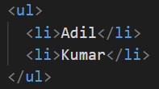
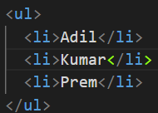
List Without Keys

Slide 4
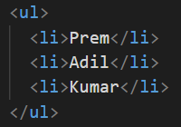
List Without Keys

Slide 5
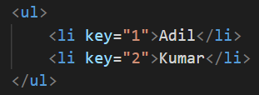
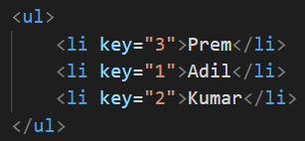
List With Keys

Slide 6
List And Keys In React
Keys allow React to keep track of elements.
This way, if an item is updated or removed, only that item will be re-rendered instead of the entire list.
Keys need to be unique to each sibling.
Generally, the key should be a unique ID assigned to each item. As a last resort, you can use the array index as a key

Slide 7
List And Keys In React
A “key” is a special string attribute you need to include when creating lists of elements in React.
Keys are used to React to identify which items in the list are changed, updated, or deleted.
In other words, we can say that keys are used to give an identity to the elements in the lists.
Keys help React identify which items have changed, added or removed.
Help in efficient update of the user interface.

